Slide 1


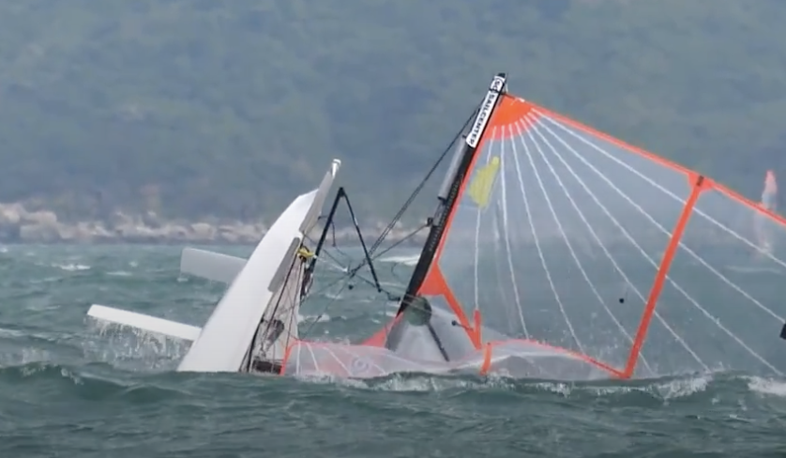
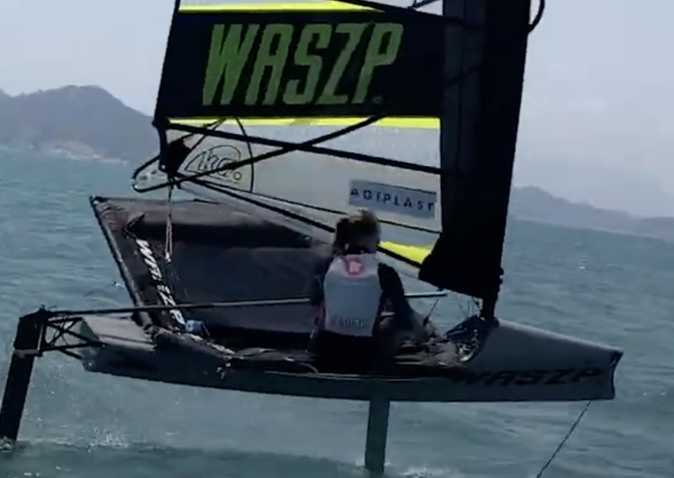

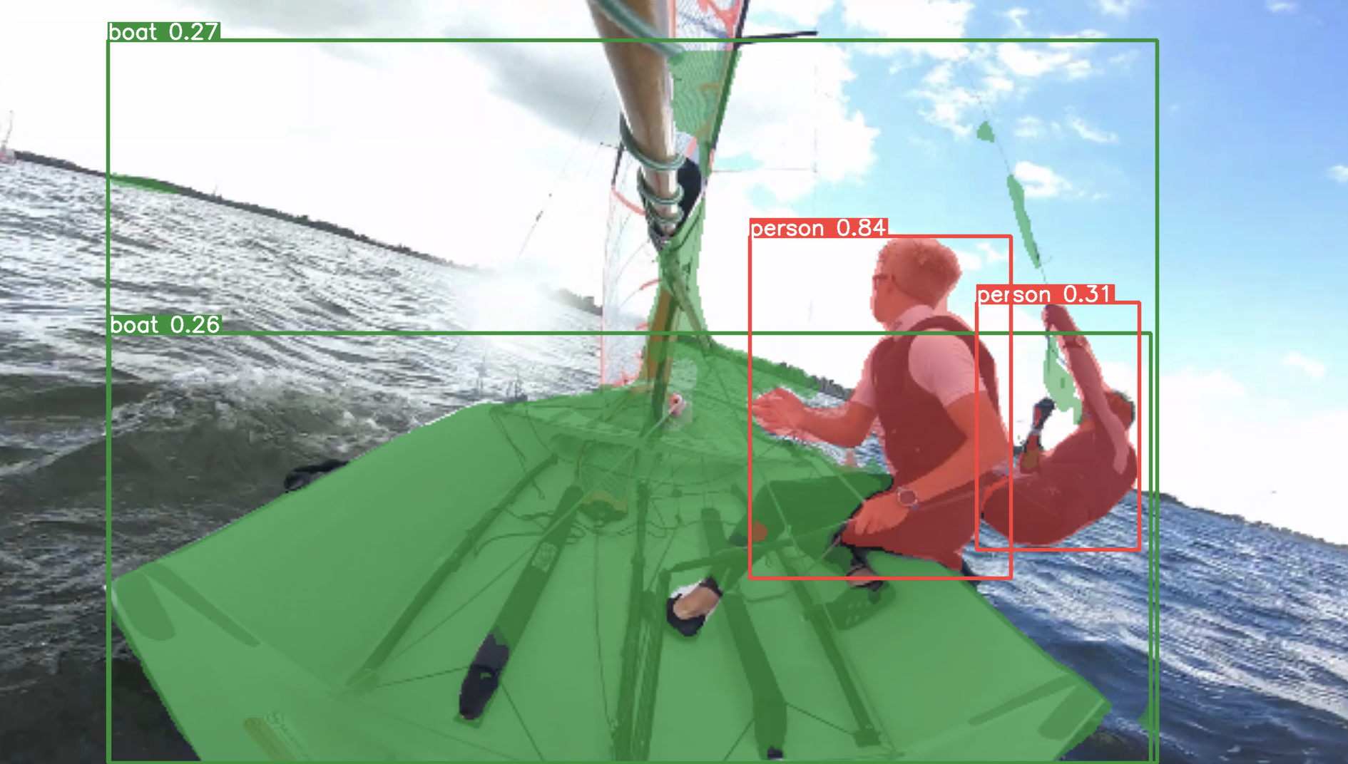
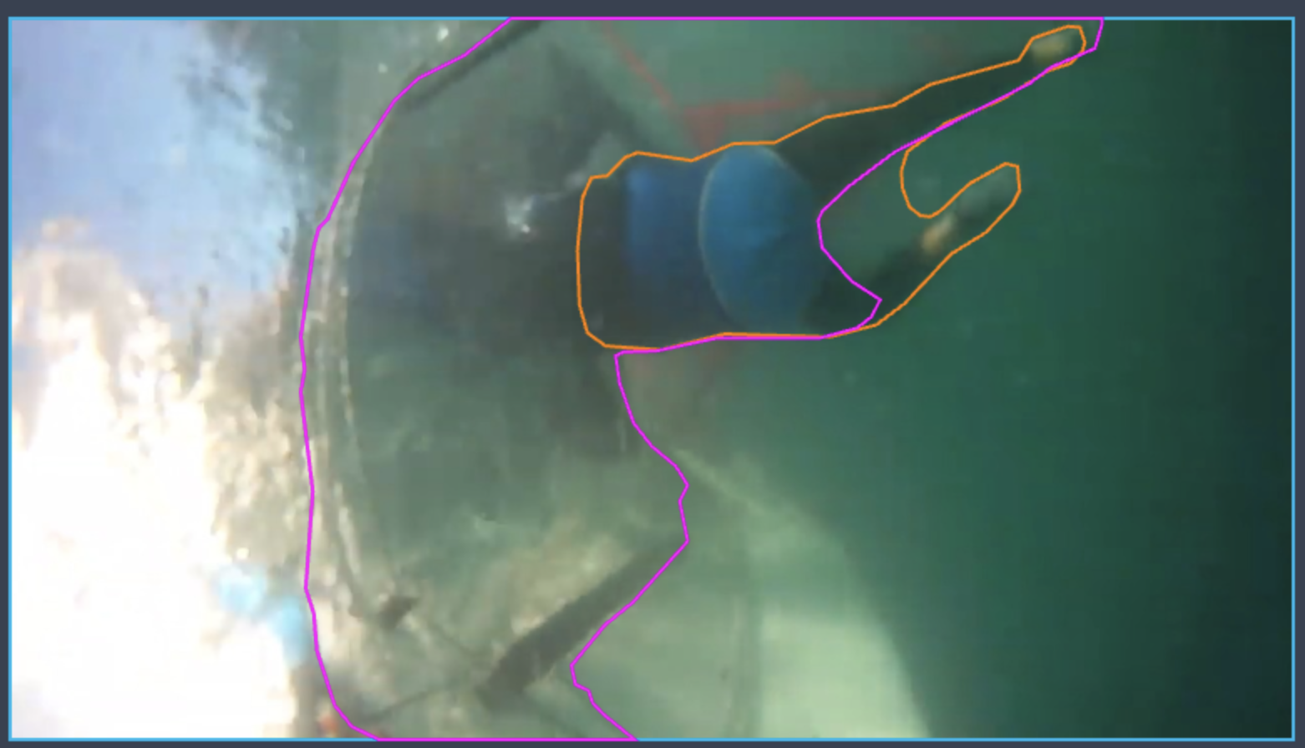

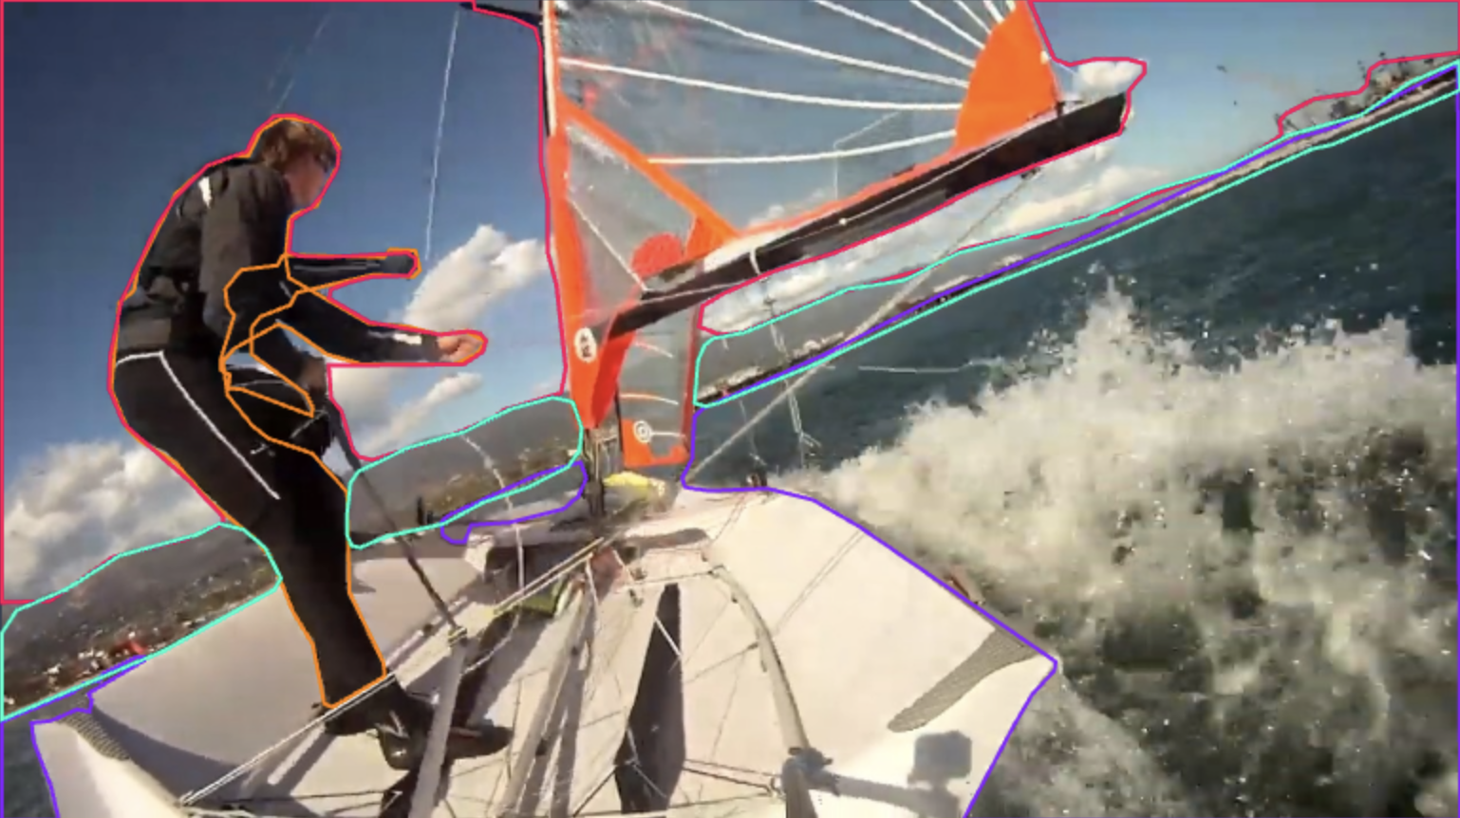
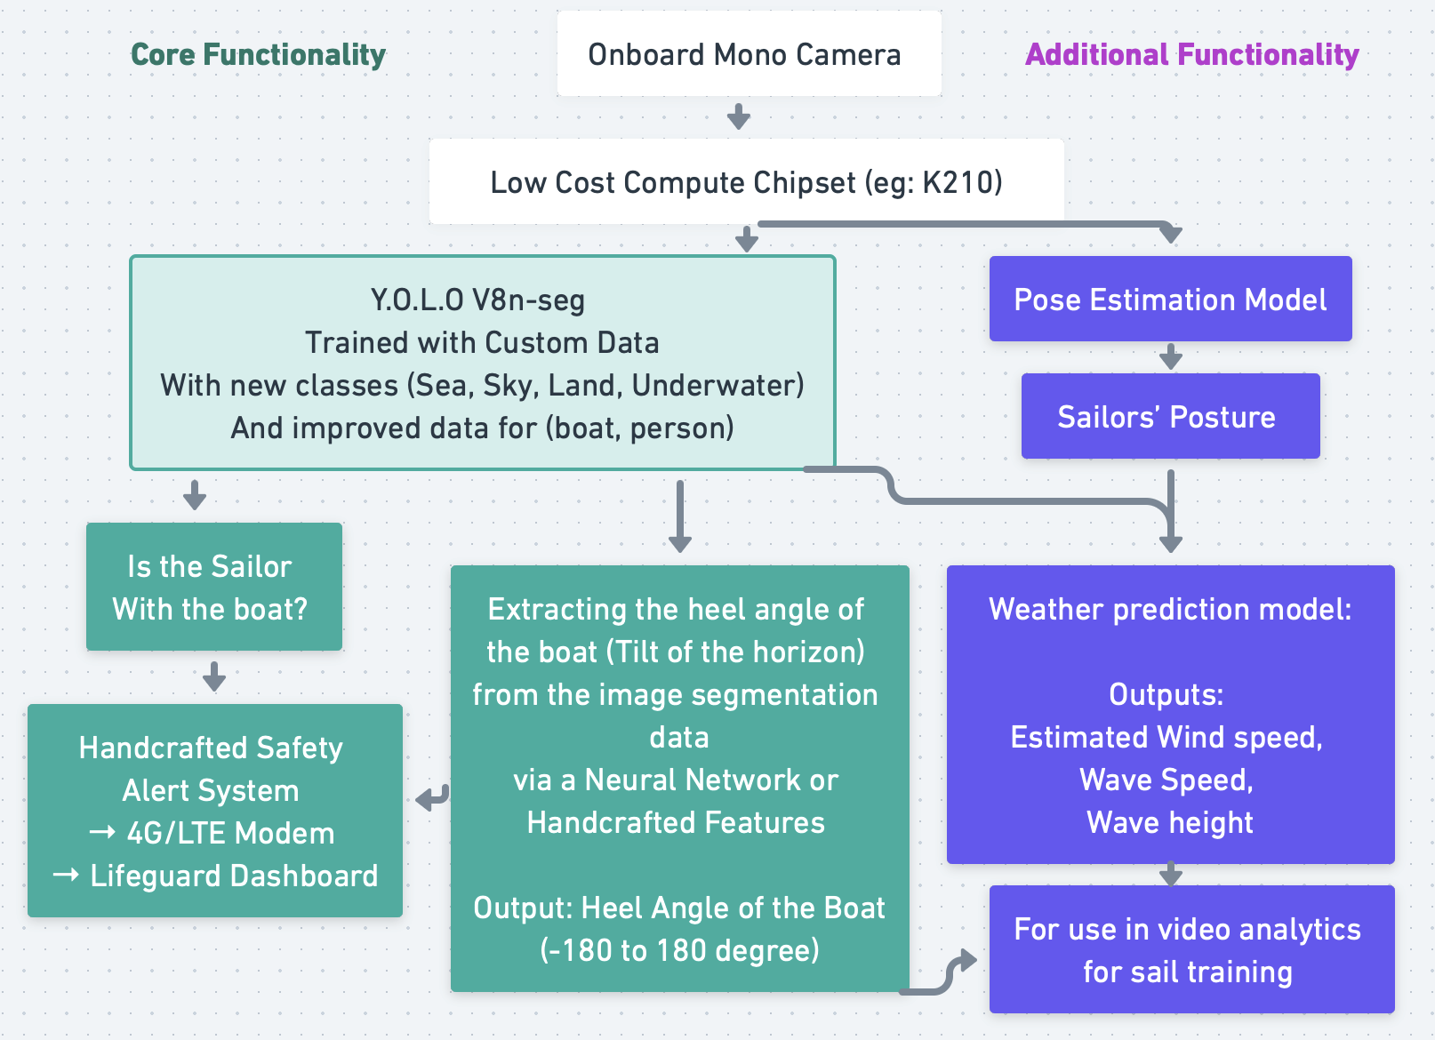
AIoT Coding, Engineering and Entrepreneurial Skills Education for Gifted Students
Safely Sail (AI)
Student(s): 33 (Clement) Tong Yuk Chun Project ID: P27
Abstract
Results/Application
Safely Sail (AI) is a computer vision and AI based Sailing Safety Monitor that detects dangerous situations on sailing dinghies, and alerts lifeguards via the cellular network for timely rescues. It is as if there were a pair of eyes on every boat in the fleet 24/7, allowing for faster rescues and more lives saved.
Adopted various approaches for identifying the horizon, including handcrafted features (Canny Edge Detection + Hough Transform), and image segmentation with YOLO and Otsu
Decided to take the path of retraining the YOLO V8n-seg with custom dataset
As it the model has a relatively lightweight architecture, it can be implemented on the edge at low cost (eg: K210 – approx. $30 HKD for the chipset, $<200 for the whole system)
Objective/Background/Motivation
Sailing is an exhilarating sport that is gaining traction by the year. However, it also has hidden dangers. Numerous high-profile deaths and serious injuries have occurred due to boats capsizing and sailor entrapment, or sailors being blown out to the sea. These incidents often go unnoticed until hours or days later, when it is too late.
YouTube Link
Methodology
A Deep Learning + Computer Vision based approach to extract various data from a camera onboard the sailing dinghy
Stage 1: Training and Evaluating the model on existing footage from action cameras mounted on the boat
Stage 2: Quantizing the model and deploying it to onboard systems
GitHub Link
Discussion/Conclusion
Large variations in lighting conditions, boat types, landmarks, and more make the task of segmentation and tilt detection more challenging
Improvements are needed for data annotations for segmentation as it is quite time consuming
Future Improvements:
Investigate the use of synthetic data generation to create more diverse environments to generalize the model further
Implement more additional features for other purposes (eg: Training video analysis)
Deploy it to a whole fleet at sailing centers

